Slide 1


Eduembed :
Embedding for Education
Project Review - 1
Under Supervision Of:
Prof. Srinath Srinivas
Anurag Mohanty
By:
Krutik Patel (IMT2021024)

Slide 2
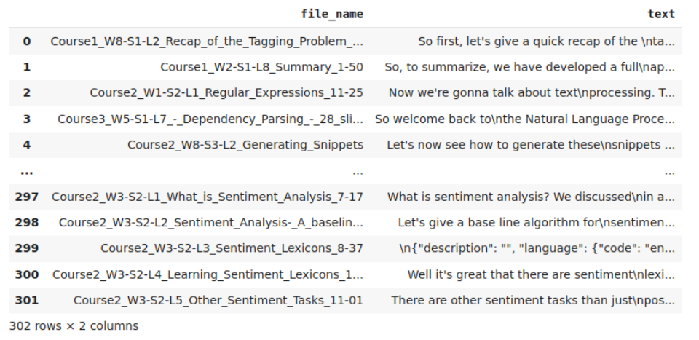
About Project
Generating custom embeddings for Education/ Academic domain.
Data gathered from online educational platform (Lecture transcript and its metadata).
Data preprocess and extract features/probability score using LDA, TF-IDF, etc.
Using knowledge graphs to represent linguistic context in the form of embeddings.
Notes:
The heart of the knowledge graph is a knowledge model: a collection of interlinked descriptions of concepts, entities, relationships and events. Knowledge graphs put data in context via linking and semantic metadata and this way provide a framework for data integration, unification, analytics and sharing.

Slide 3
Knowledge Graph Embeddings
KG represent diverse types of information in the form of different types of entities connected via different types of relations.
Information extracted from KGs in the form of embeddings is used to improve search, recommend products, and infer missing domain specific context.
Popular KGE models are TransE, TransH, etc. which define different score functions to learn entity and relation embeddings.
Input data for KGE is in the form of triplets (head, relation, tail).
Notes:
It is however hard to train KG embeddings from graphs with millions of nodes and billions of edges.
The vertices of the knowledge graph are often called entities and the directed edges are often called triplets and are represented as a (h, r, t) tuple, where h is the head entity, t is the tail entity, and r is the relation associating the head with the tail entities.

Slide 4

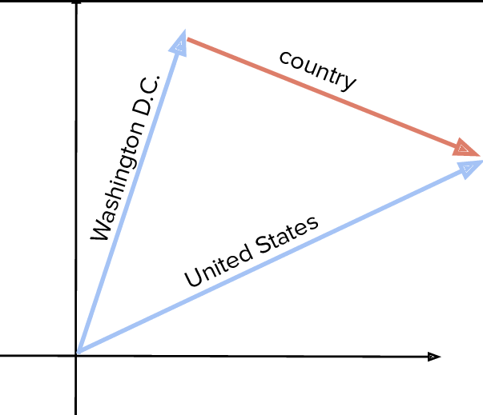
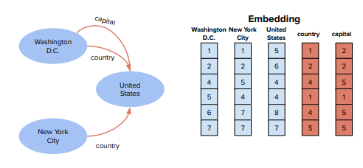
TransE

Slide 5
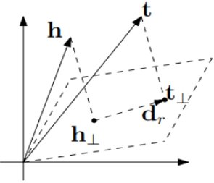
TransH

Slide 6
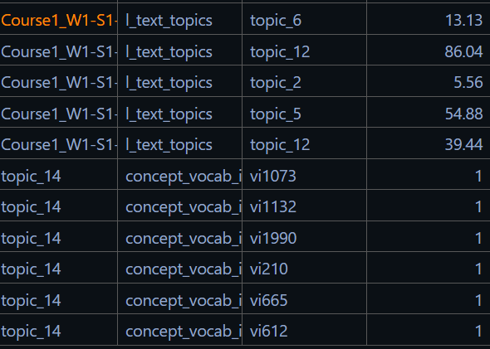
Triplets for Knowledge Graph

Slide 7
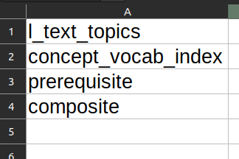
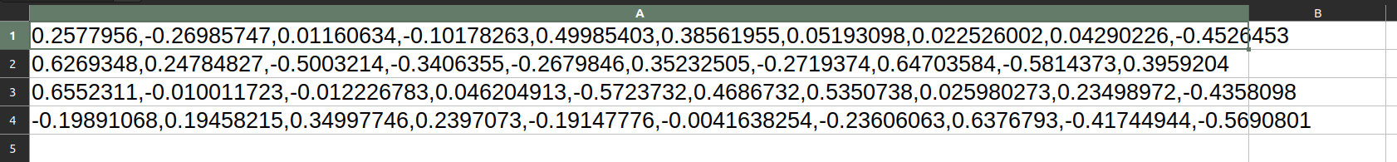
Embedding Generation
Generated Embeddings for Entities and Relations
Currently we have 2000+ unique entities
And 4 relations

Slide 8
Week 1: Environment and Project Setup
Challenges faced:
Package Dependency issues.
Setting Up the Environment for the Project

Slide 9
Week 2: Comprehension of Code and TransE/TransH models
Read TransE/TransH papers
Familiarized myself with the models and their workings
Tested the models on FB15k dataset.

Slide 10
Week 3: Increased concept-vocab words, pipelined preprocessing code
Introduced more words in concept-vocab for increasing model accuracy
Pipelined Preprocessing Code.

Slide 11
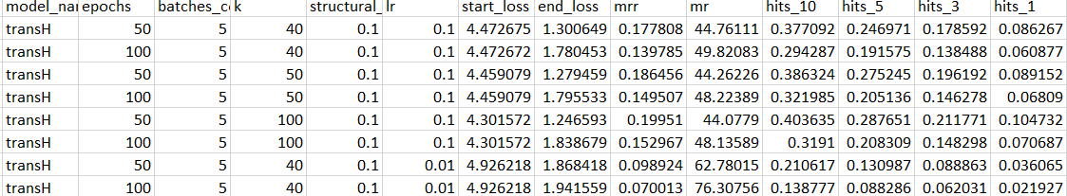
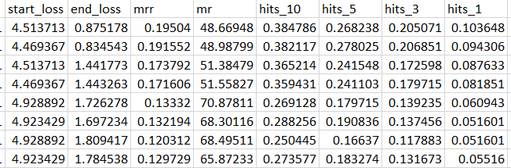
Week 4: Used OpenAI API to generate concept-vocab
Used OpenAI API to get more concept-vocab from the text.
Better Results with more concept-vocab!!
After Before

Slide 12
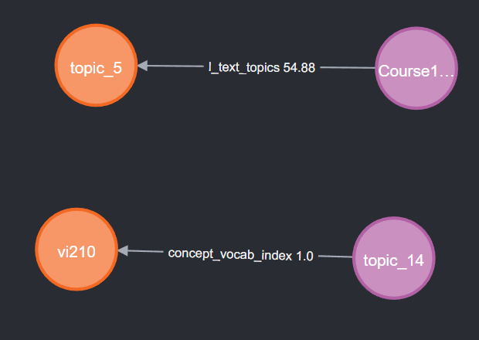
Week 5: Visualization using Neo4j Graph DB

Slide 13
Future Plan
Get l_text_topics from LLMs like Llama and LangChains
Use the Embeddings to Predict new Relationships

Slide 14
THANK YOU

